Slide 1

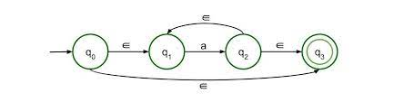


NFA -ε

Slide 2

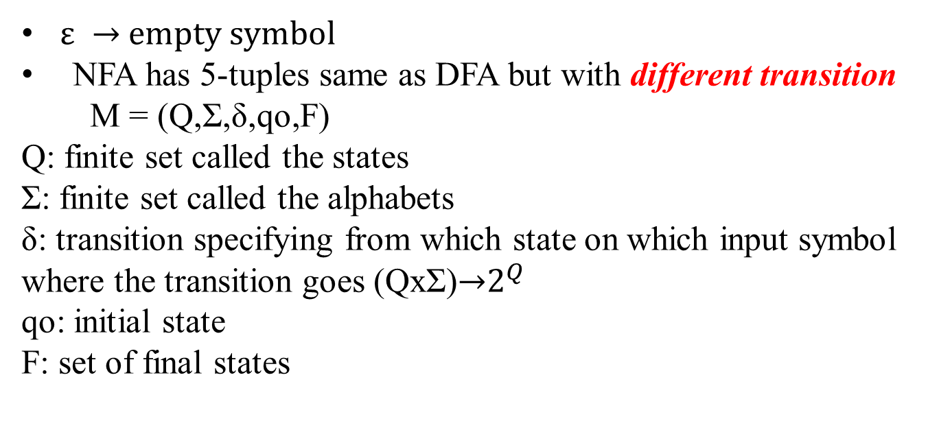
NFA with ε
ε → empty symbol
NFA has 5-tuples same as DFA but with different transition
M = (Q,Σ,δ,qo,F)
Q: finite set called the states
Σ: finite set called the alphabets
δ: transition specifying from which state on which input symbol where the transition goes (QxΣ)→$2^{Q}$
qo: initial state
F: set of final states
3

Slide 3
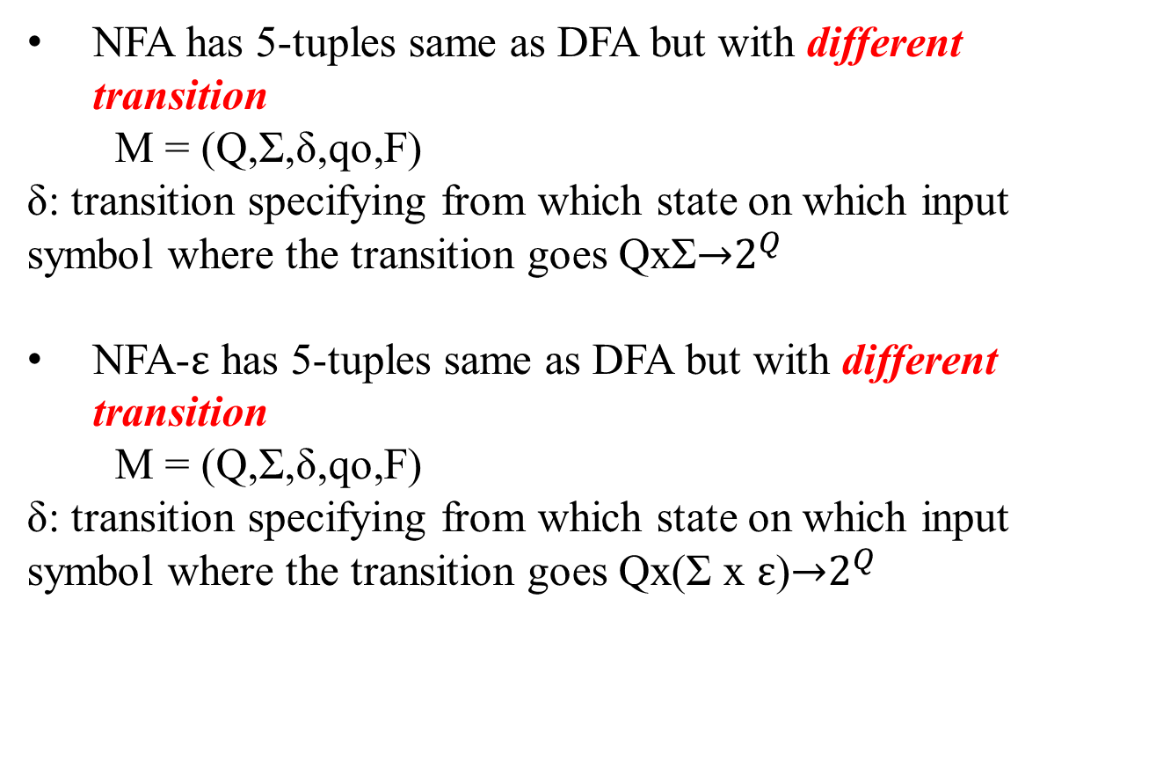
Definition of NFA
NFA has 5-tuples same as DFA but with different transition
M = (Q,Σ,δ,qo,F)
δ: transition specifying from which state on which input symbol where the transition goes QxΣ→$2^{Q}$
NFA-ε has 5-tuples same as DFA but with different transition
M = (Q,Σ,δ,qo,F)
δ: transition specifying from which state on which input symbol where the transition goes Qx(Σ x ε)→$2^{Q}$
3

Slide 4
Example ε-NFA
3

